Slide 1

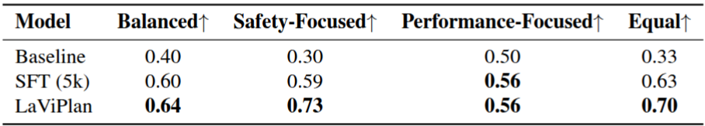


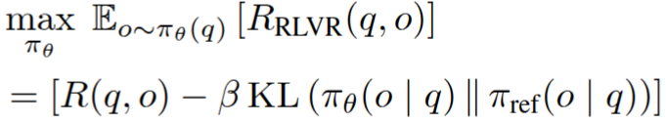
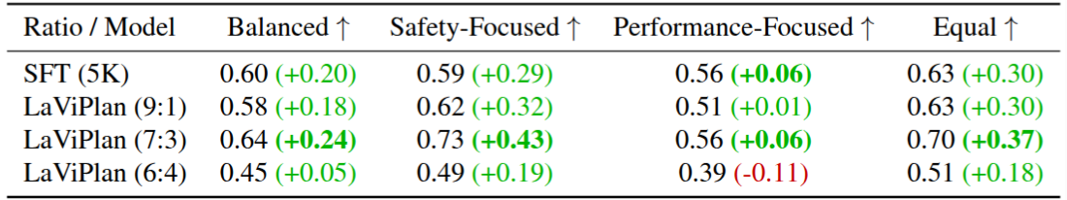



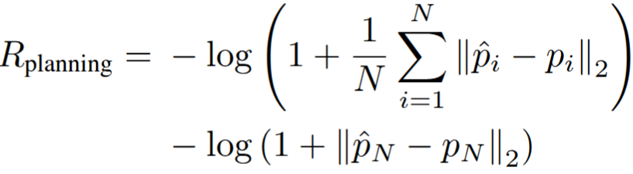
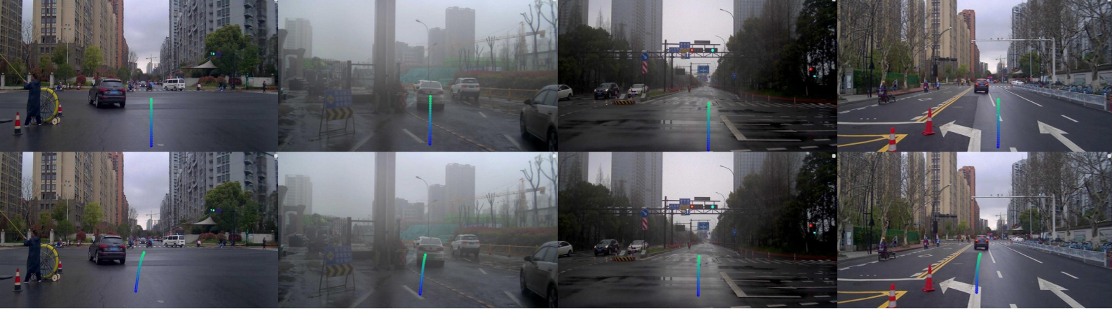
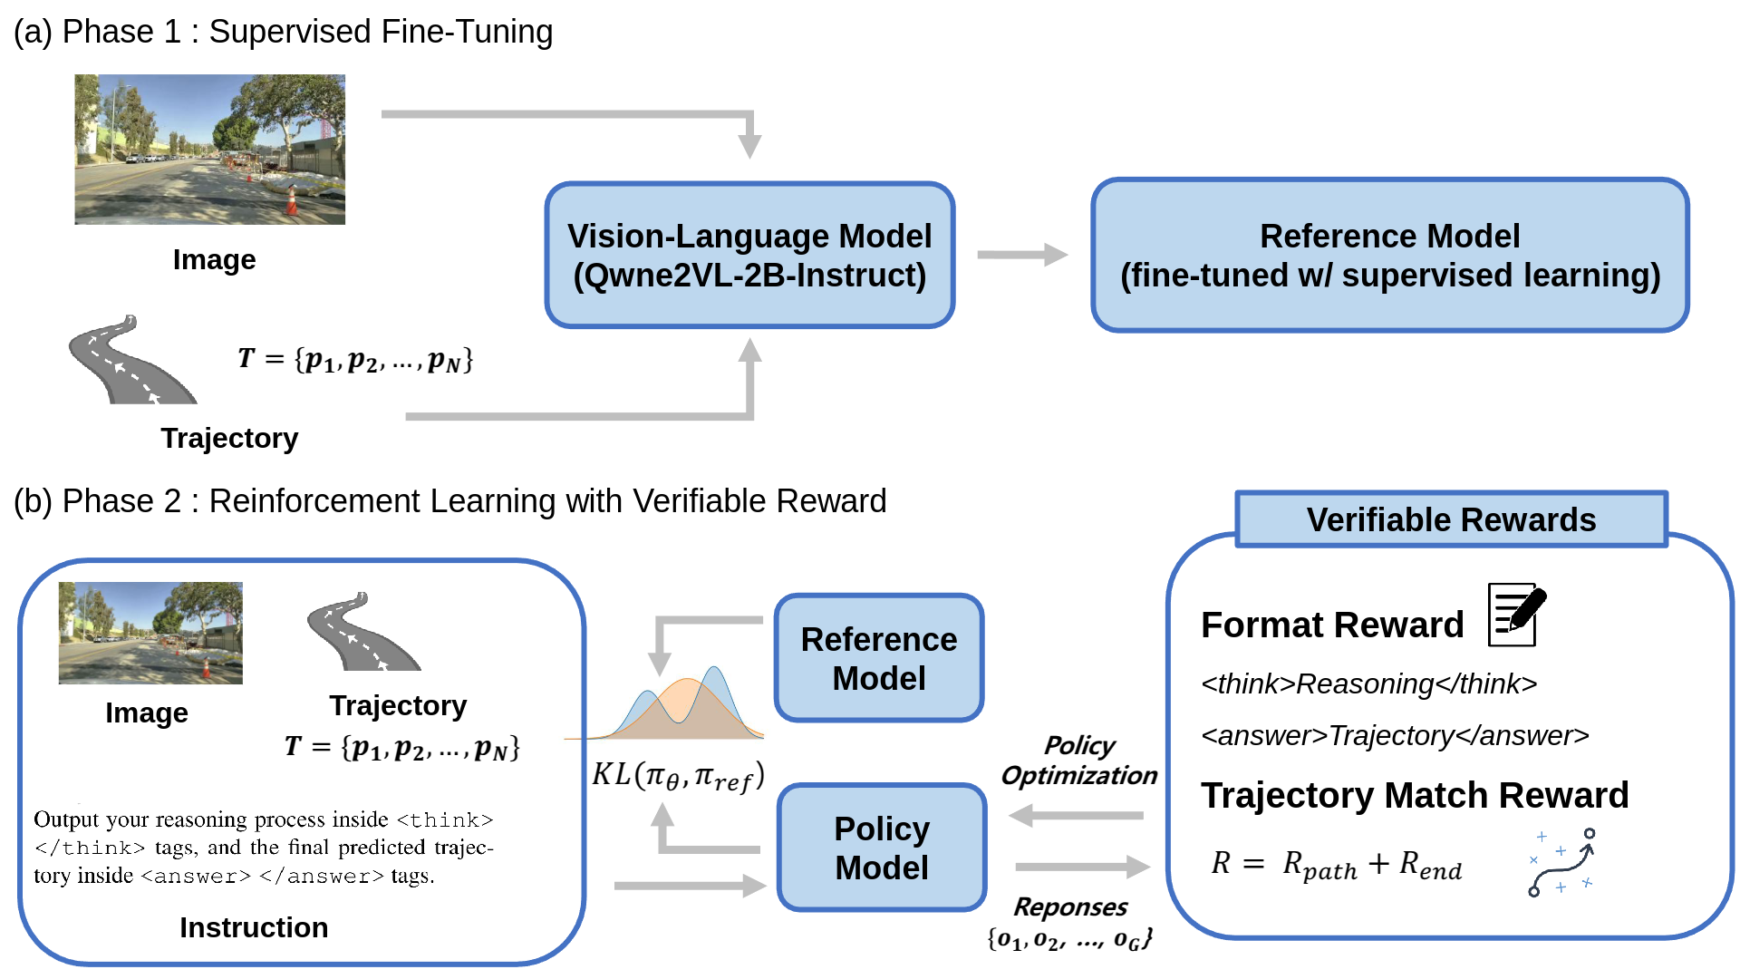
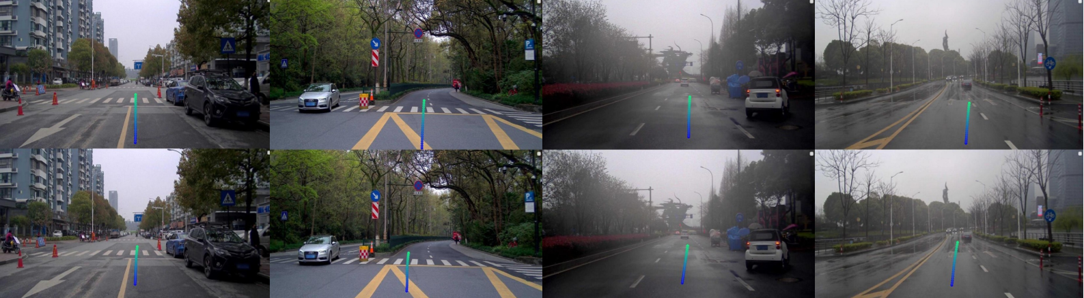
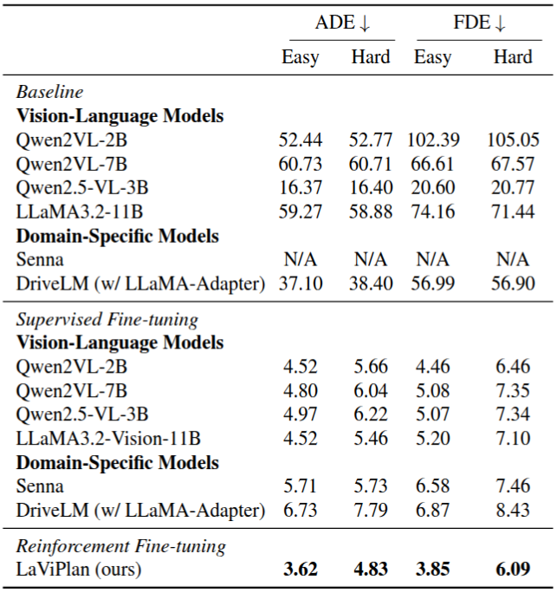
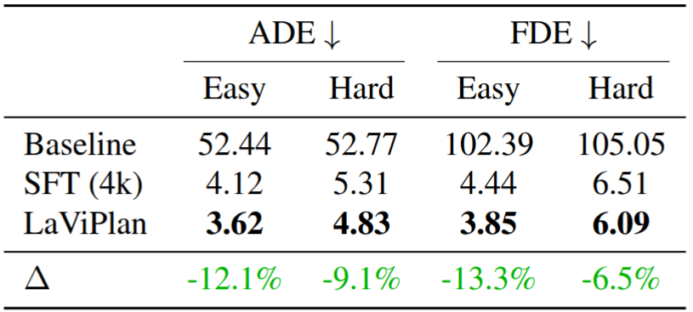
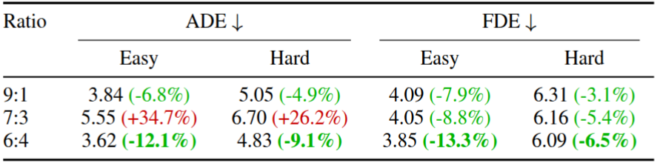
LaViPlan : Language-Guided Visual Path Planning with RLVR
Hayeon Oh
LLM agent for autonomous driving has misalignment problem in vision-language-action
Post-training with reinforcement learning (RL) has shown generalization, memory efficiency, and alignment (e.g., RLHF)
⇒ What if we leverage RL with LLM for autonomous driving?
Phase 1 : supervised fine-tuning (SFT)
Instruction tuning enables reasoning-guided waypoint prediction for path planning.
Phase 2 : reinforcement fine-tuning (RFT) with GRPO for vision-language-action alignment
Post-training with the group relative policy optimization (GRPO) can align language and action by maximizing planning-oriented reward following the objective function below :
The reward is based on image-plane displacement errors between predicted and ground-truth waypoints.
Results in ROADWork (in-domain dataset)
ADE : average displacement error, FDE : final displacement error
Results in CODA-LM (out-domain dataset)
Qualitative Analysis
Trajectories before (up) and after RFT (down), showing alignment
Summary : leveraging GRPO to align vision, language, and action
Limitation : spare reward depending on the entire rollout
Future work :LLM agent for autonomous driving capable of causal and counterfactual reasoning for safe, interpretable decision
1. Motivation
.
Evaluation under varying penalty weights in zero-shot scenarios
An excavator and traffic cones are on the right side.
Language (scene understanding)
Action (decision-making)
Effect of Easy-to-Hard Data Ratio in out-domain dataset
2. Method
3. Experiment
RFT after SFT yields performance gains across all scenarios
4. Conclusion
All models used 5K samples: 4K for LaViPlan’s SFT and 1K for its RFT
Effect of Easy-to-Hard Data Ratio (Fixed Total Samples)
Notes:
<number>

